Slide 1



Introduction to Neural Networks
Neural networks are a powerful tool for machine learning, inspired by the structure and function of the human brain. They are capable of learning from data and making predictions, making them valuable in various fields, including image recognition, natural language processing, and self-driving cars.
by Hina Ali

Slide 2
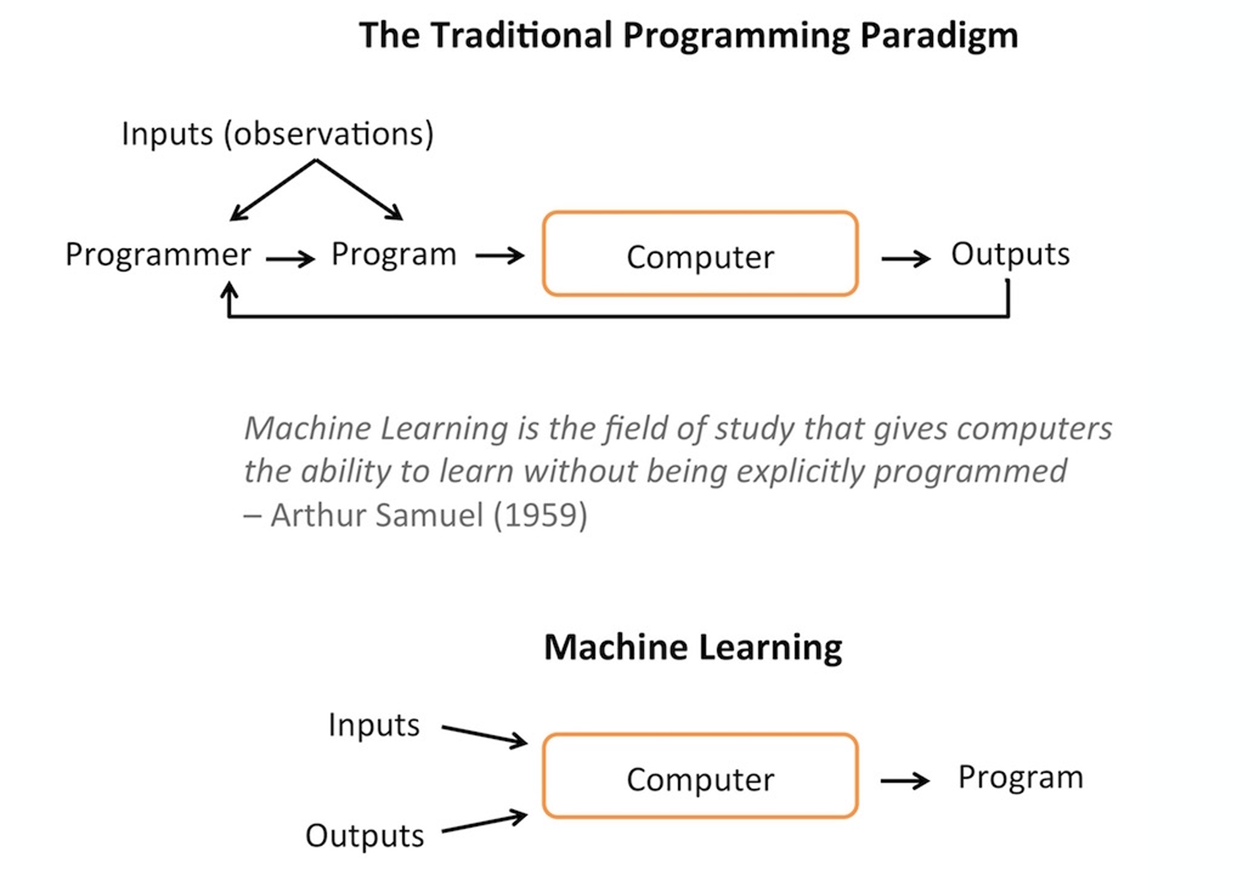
Adopted

Slide 3

History of Neural Networks
1
1940s-50s: Early Concepts
The foundation of neural networks was laid with the development of the perceptron, a simple model of a neuron, and the exploration of early learning algorithms. Neural networks were conceived in the 1940s,
2
1960s-70s: Rise and Fall
Neural networks gained momentum but faced limitations with complex problems, leading to a period of stagnation. how to train them remained a
mystery for 20 years, The concept of backpropagation (explained later) came in the 1960s,
3
1980s-Present: Revival and Breakthroughs
Advancements in computing power, algorithms, and data availability sparked a resurgence in neural networks, leading to remarkable progress in various applications.
started winning competitions in 2010.
4

Slide 4
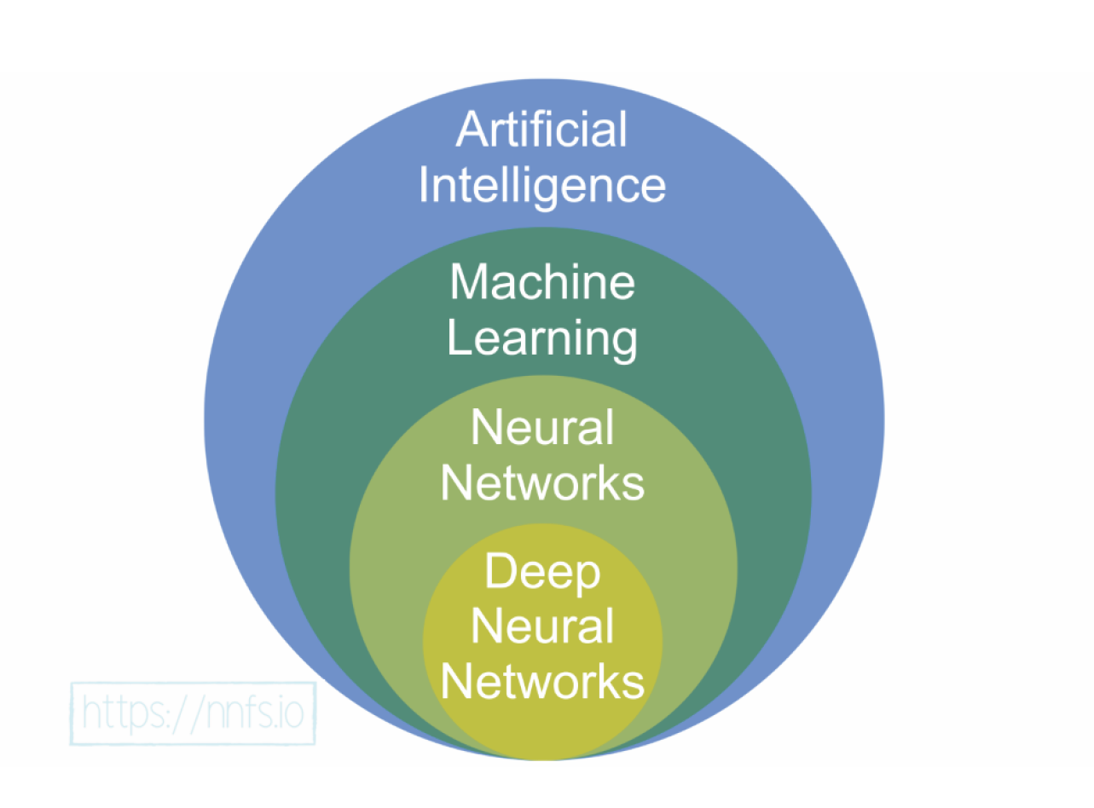

Slide 5
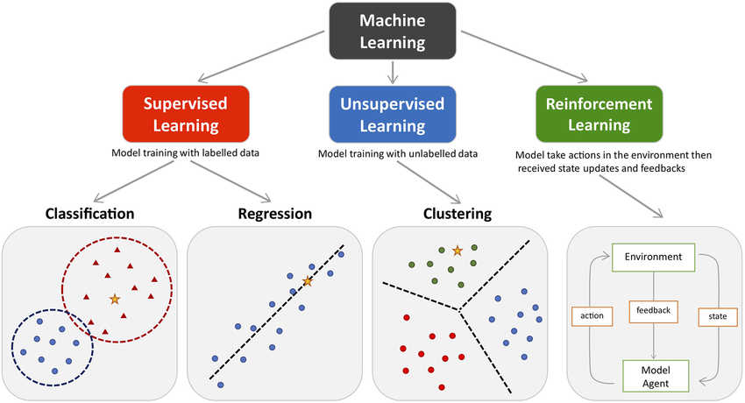
Types of Machine Learning
1
target
Adopted
feature (input, observation)
Labeled data Direct Feedback Predict Outcome/future
No labels/targets
No feedback Find hidden structure in data
Decision process Reward system Learn series of actions

Slide 6
Supervised learning: This is the simplest form of learning as it consists of a labeled dataset, where the neural network needs to
find patterns that explain the relationship between the features and the target. The iterations during the learning process aim to
minimize the difference between the predicted value and the ground truth. One example of this would be classifying a plant based
on the attributes of its leaves.
Unsupervised learning: In contrast with the preceding methodology, unsupervised learning consists of training a model with
unlabeled data (meaning that there is no target value). The purpose of this is to arrive at a better understanding of the input data,
where, generally, networks take input data, encode it, and then reconstruct the content from the encoded version, ideally keeping the
relevant information. For instance, given a paragraph, the neural network can map the words in order to output those words that are
actually key, which can be used as tags to describe the paragraph.
Reinforcement learning: This methodology consists of learning from the data at hand, with the main objective of maximizing a
reward function in the long run. Hence, decisions are not made based on the immediate reward, but on the accumulation of it in the
entire learning process, such as allocating resources to different tasks, with the objective of minimizing bottlenecks that would slow
down general performance.

Slide 7
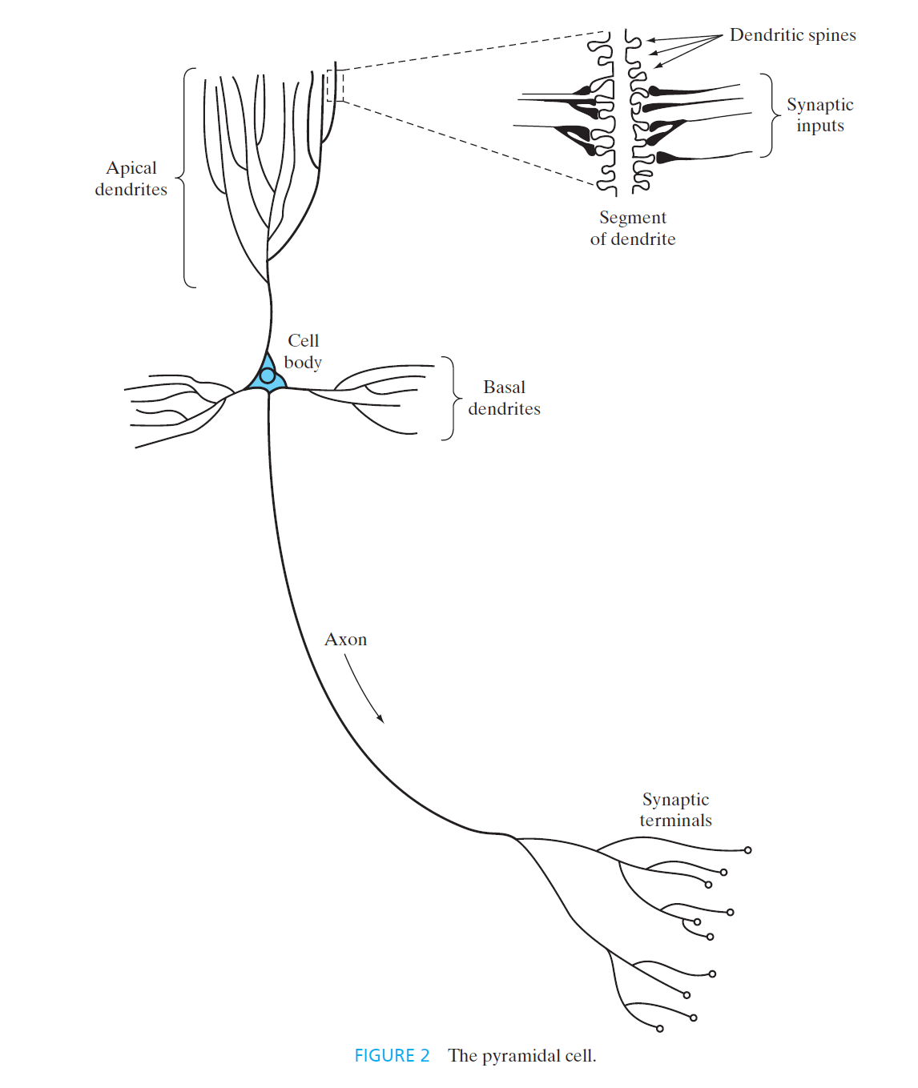
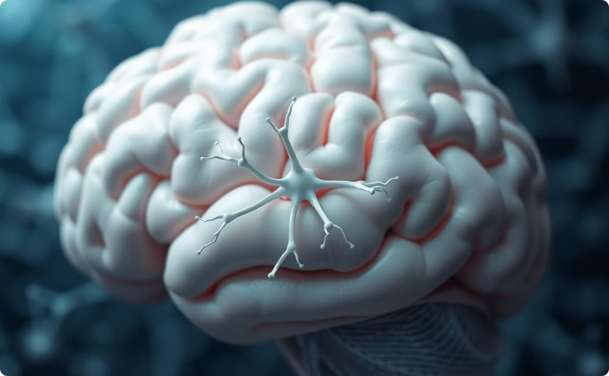
Biological Inspiration
Structure of the Brain
Function of Neurons
Neural networks are inspired by the interconnected structure of neurons in the brain, which process and transmit information through electrical signals.
Neurons receive input from other neurons through dendrites, process information in the cell body, and transmit output to other neurons through axons.
Motivation Behind Neural Networks
Human Brain vs. Digital Computers: The brain operates differently from traditional digital computers. It's complex, nonlinear, and highly parallel, allowing it to perform tasks like pattern recognition and motor control faster than the most advanced digital computers.
Example - Human Vision: The brain processes visual information swiftly, recognizing faces or scenes in just 100-200 milliseconds, a task that would take much longer for a computer.
Example - Bat Sonar: Bats use echolocation to detect and capture prey, performing complex neural computations in a brain the size of a plum. Their sonar system can discern a target's distance, speed, size, and location, showcasing the brain's computational efficiency.
Neural Network Fundamentals
Structure and Learning: At birth, the brain has a pre-structured setup but develops through experience. This plasticity, or adaptability, allows it to adjust to its environment. Similarly, neural networks, composed of artificial neurons, learn and adapt by adjusting synaptic weights.
Definition of a Neural Network:
A massively parallel processor made of simple units (neurons) that stores knowledge gained through experience.
Resembles the brain in two key ways: 1) Acquires knowledge via learning. 2) Stores knowledge in the form of synaptic weights

Slide 8
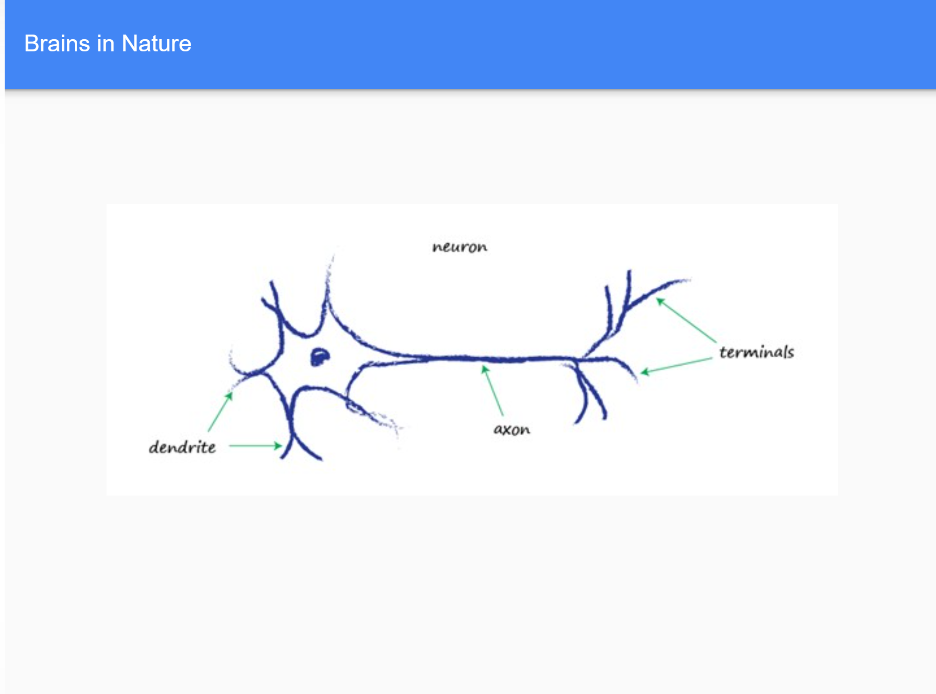
electrical signal
Neurons, although there are various forms of them, all transmit an electrical signal from one end to the other, from the dendrites along the axons to the terminals.
These signals are then passed from one neuron to another.
This is how your body senses light, sound, touch pressure, heat and so on. Signals from specialized sensory neurons are transmitted along your nervous system to your brain, which itself is mostly made of neurons too.

Slide 9
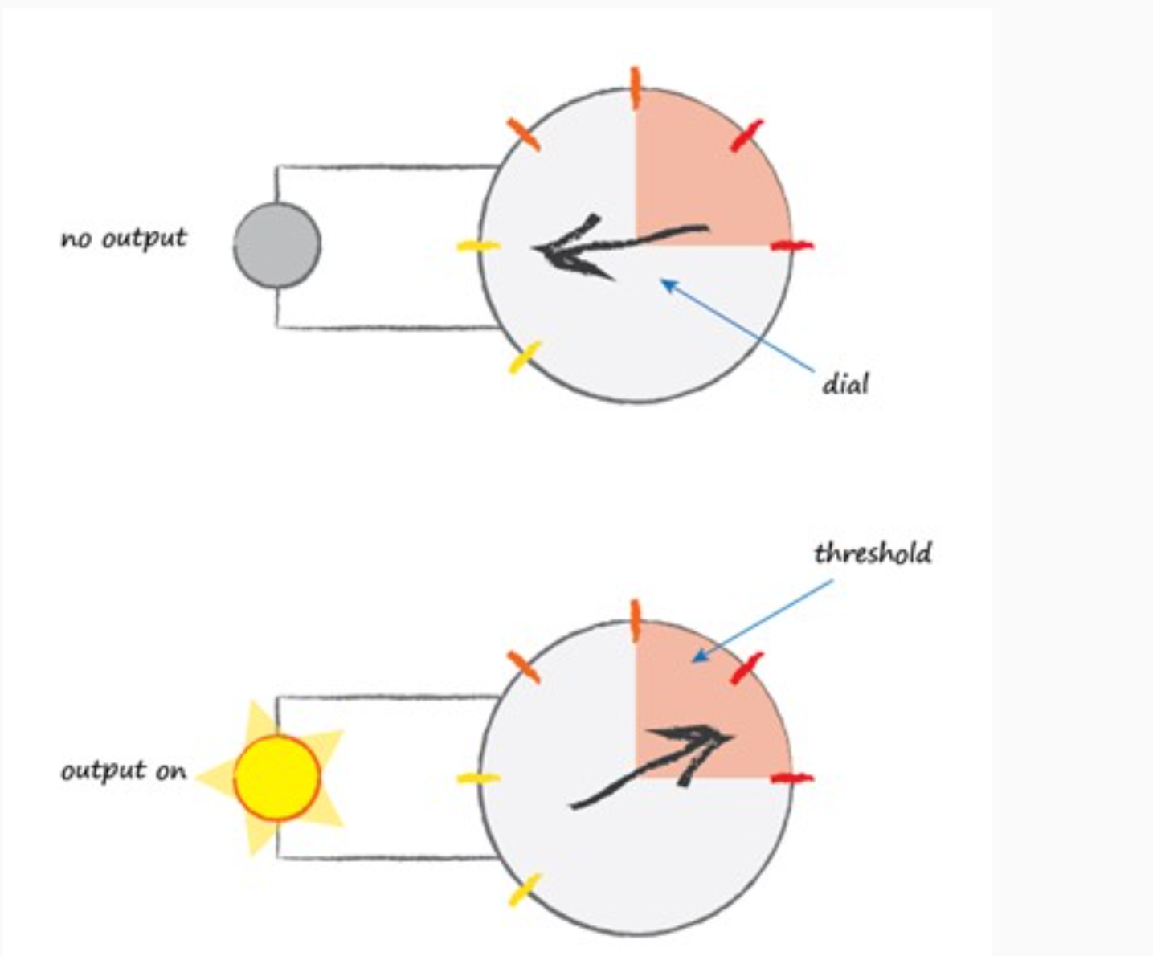
How NEURONS work
Observations suggest that neurons don’t
react readily, but instead suppress the input
until it has grown so large that it triggers
an output
A threshold : The term used by scientists describes
this as, neurons fire when the input reaches the threshold
A function that takes the input signal and generates an output signal, but takes into account
some kind of threshold is called an activation function . Mathematically, there are many such
activation functions that could achieve this effect. A simple step function could do this:

Slide 10
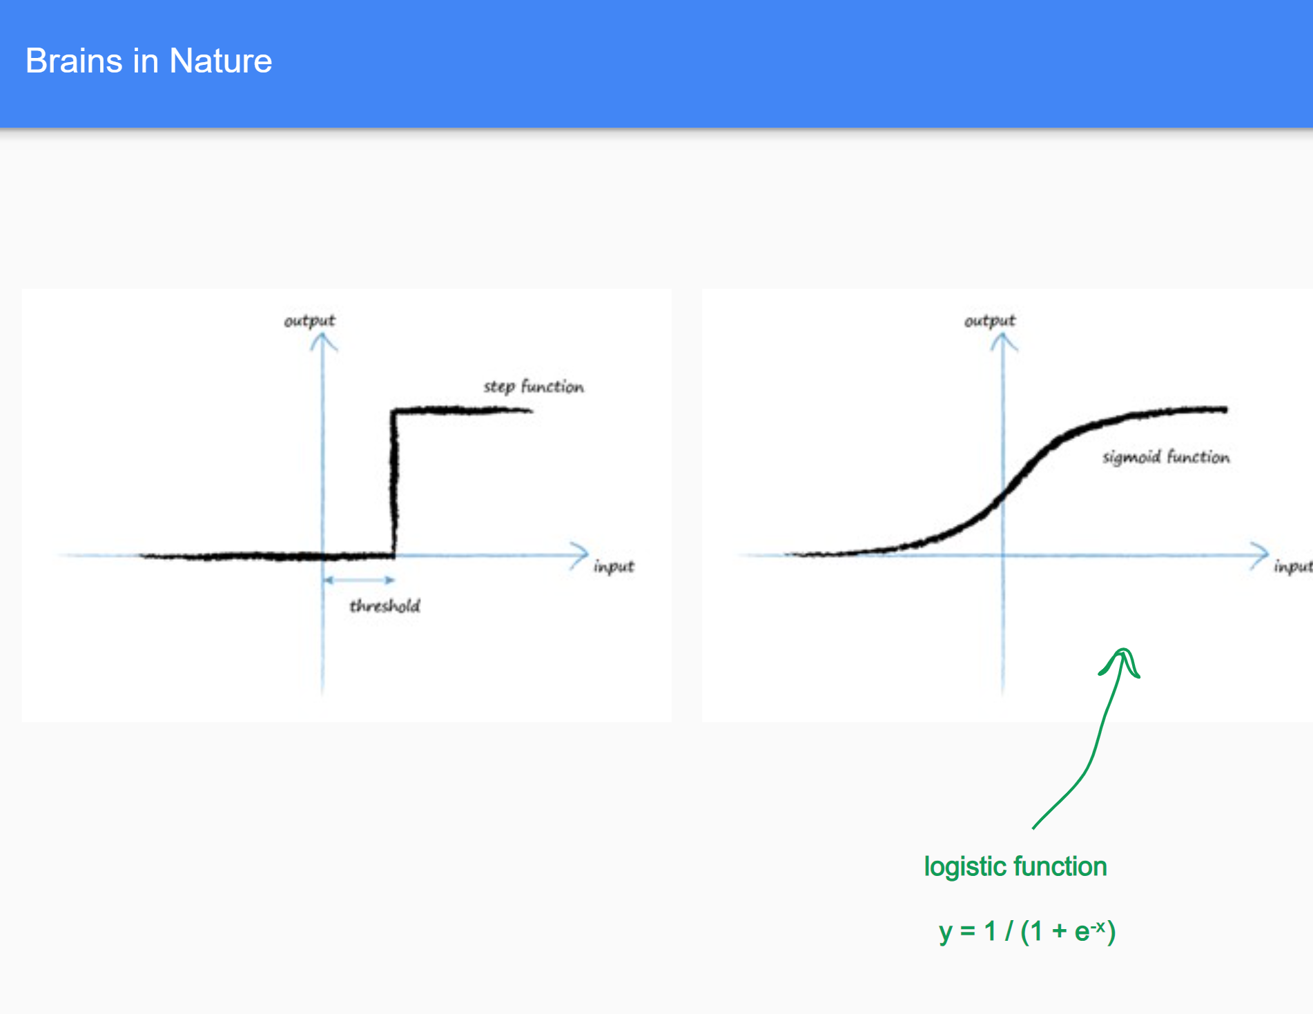
x is the input value (which can be any real number).
e is the base of the natural logarithm, approximately equal to 2.71828.
The output of the sigmoid function:
Approaches 0 as x becomes more negative.
Approaches 1 as x becomes more positive.
Is exactly 0.5 when x=0

Slide 11
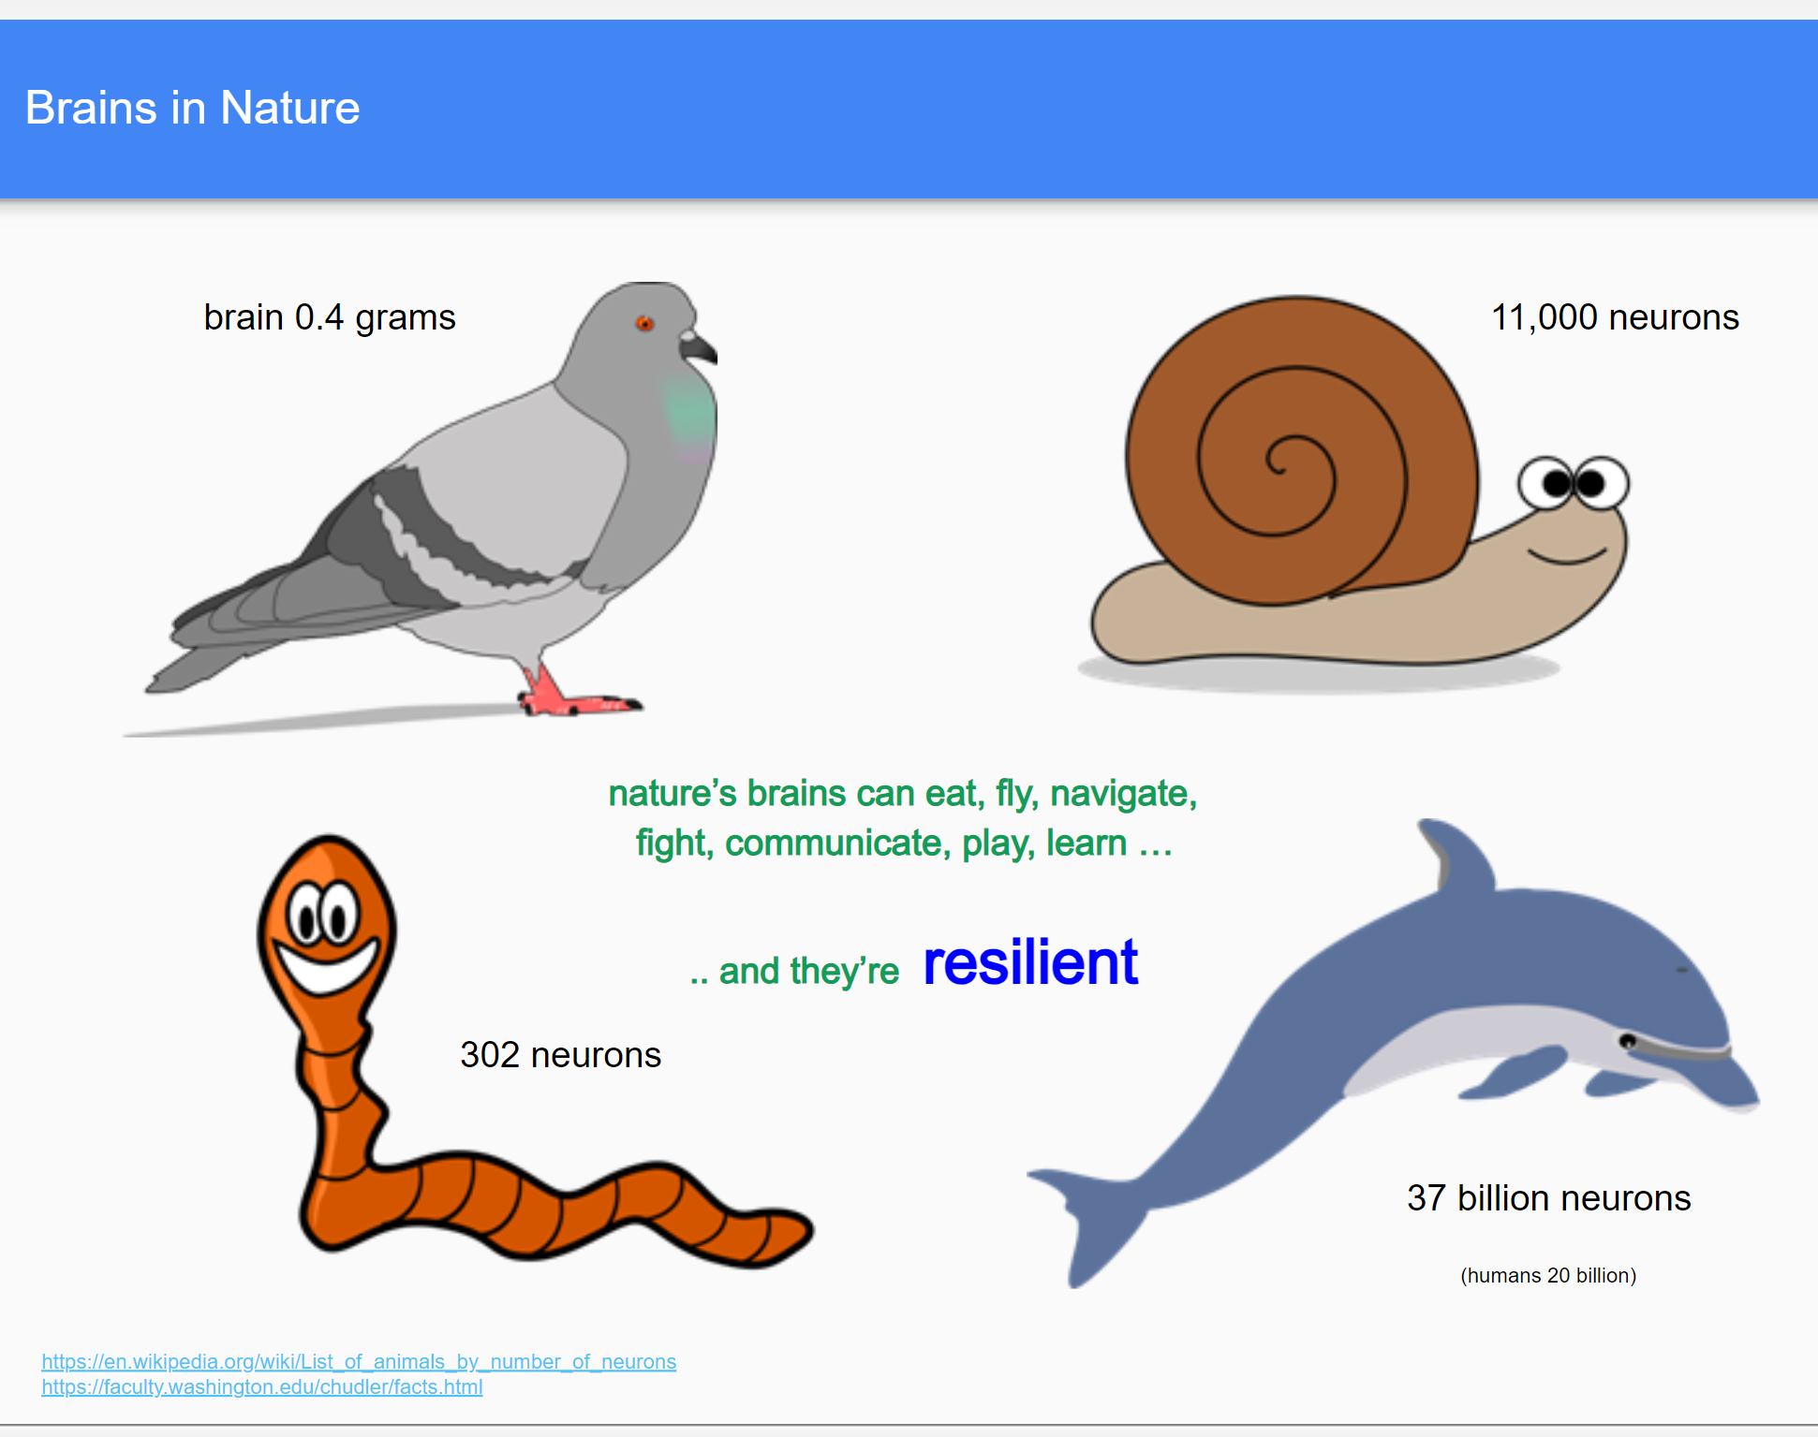

Slide 12
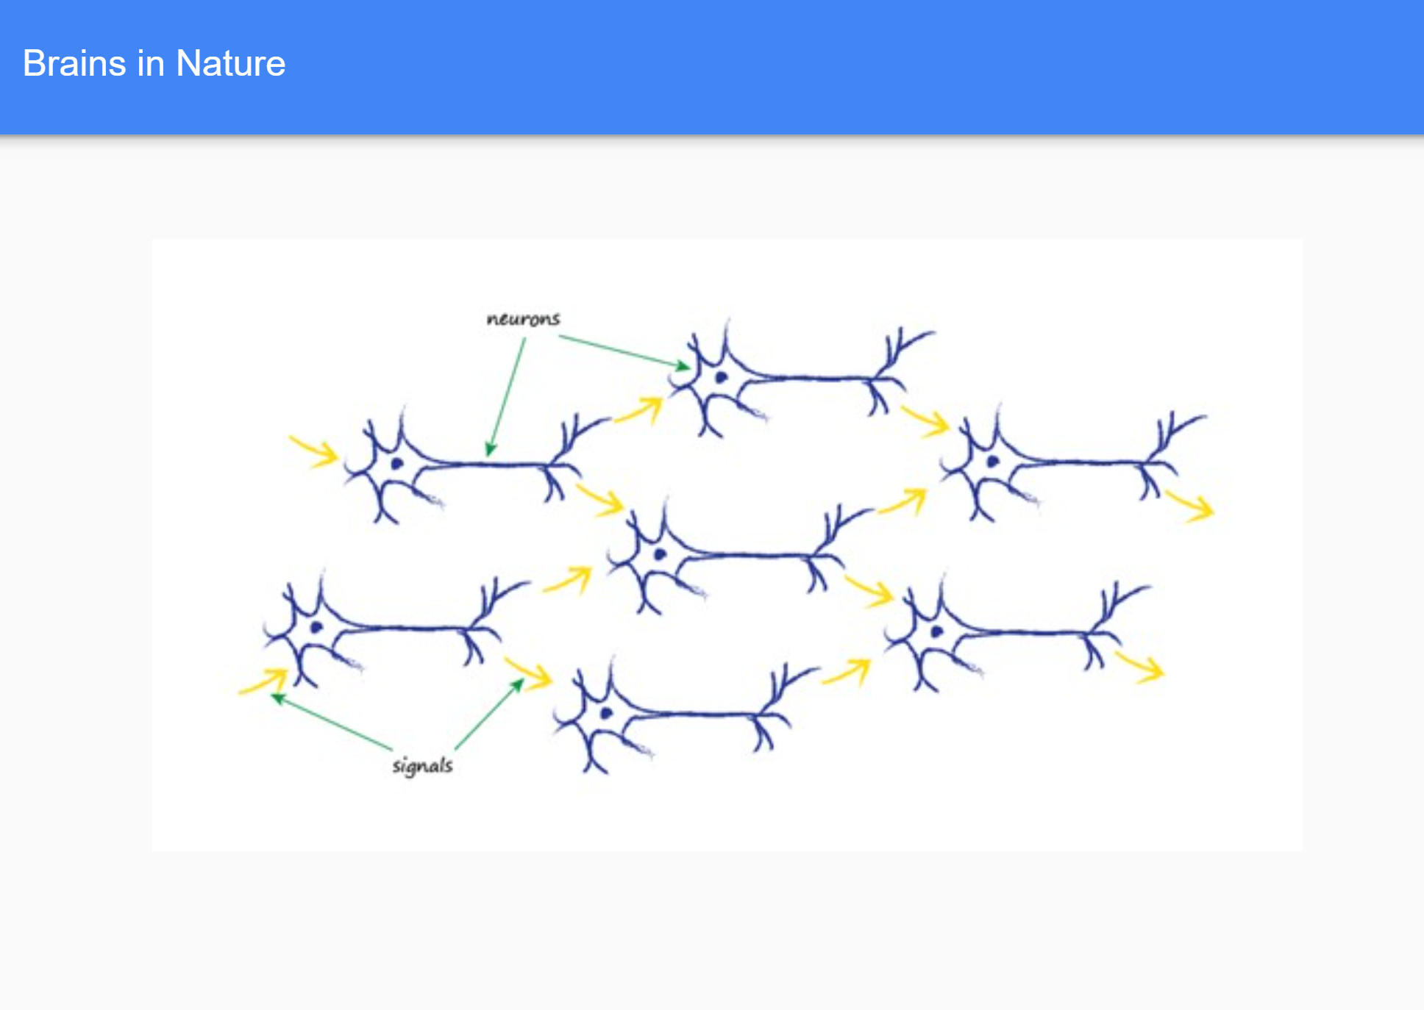

Slide 13
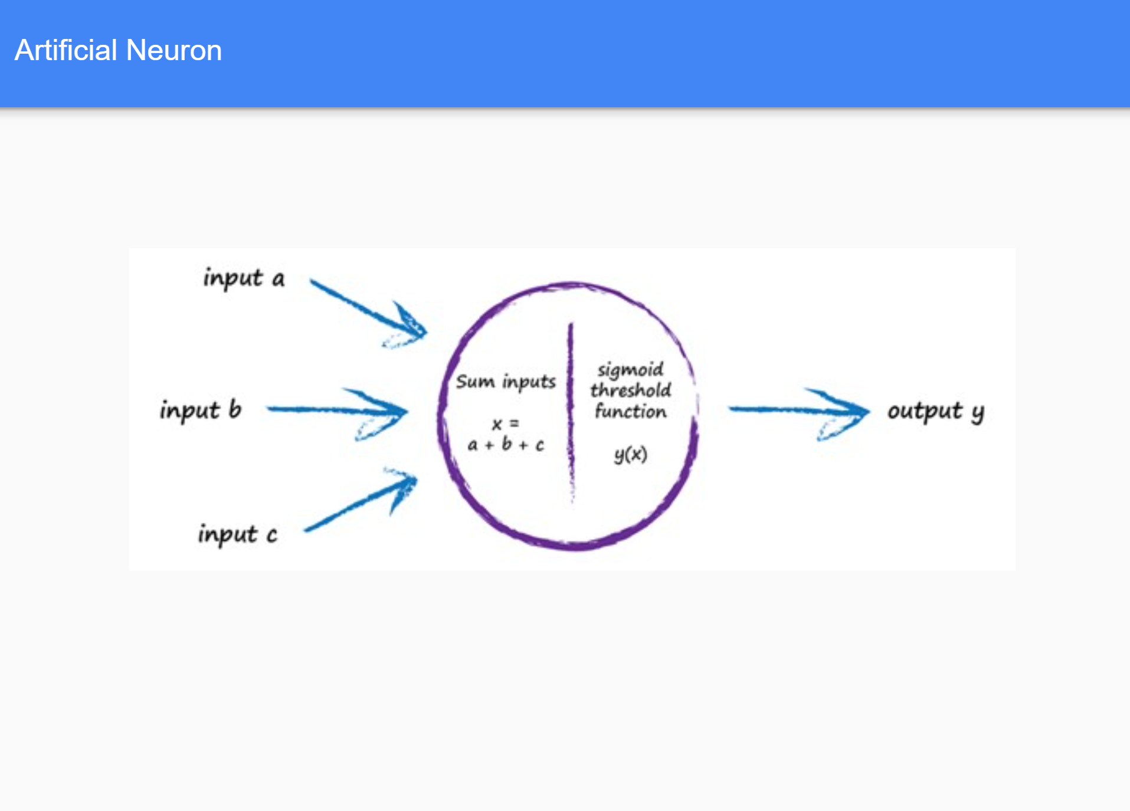

Slide 14
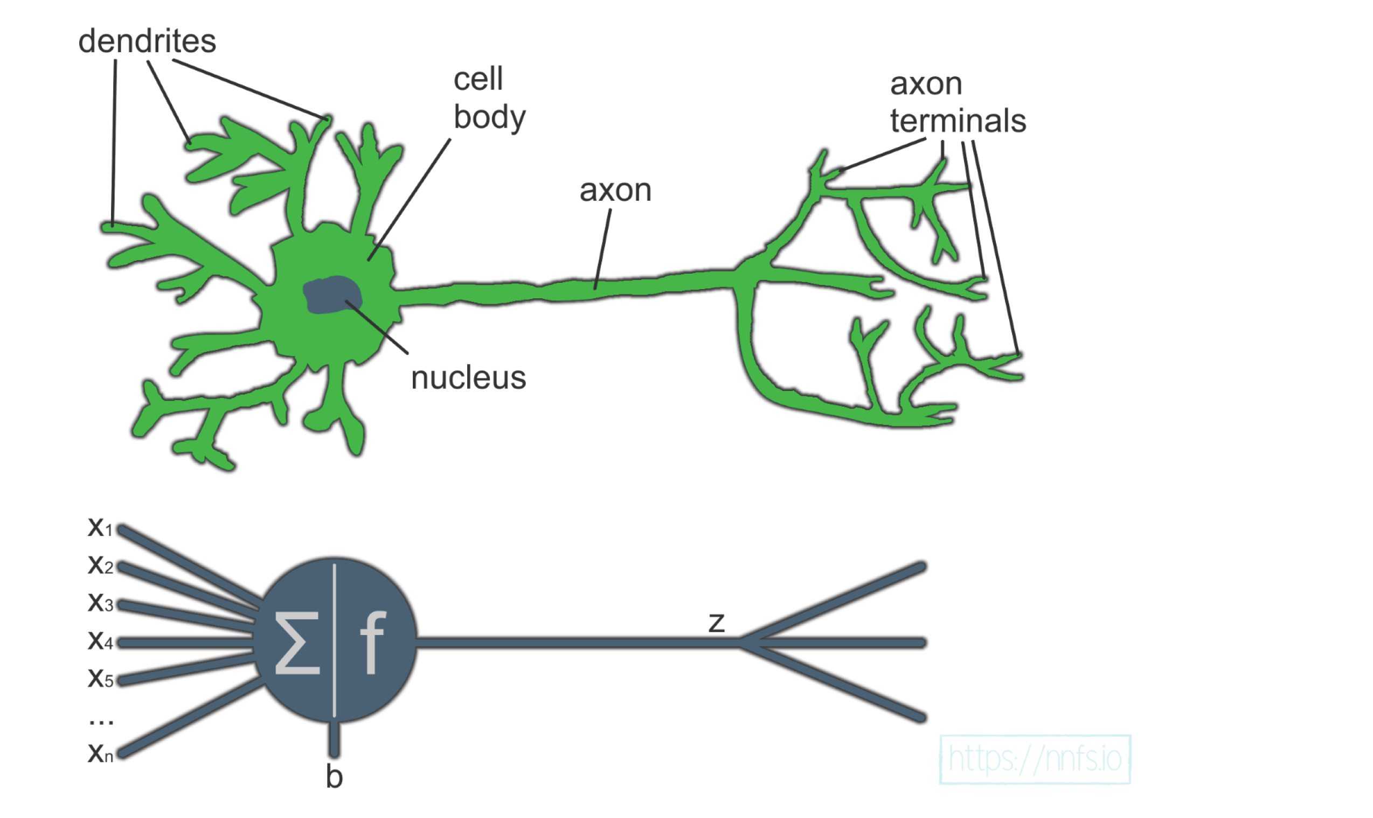
Comparison of Biological and Artificial Neuron
A single neuron by itself is relatively useless, but, when combined with hundreds or thousands (or many more) of other neurons, the interconnectivity produces relationships and results that frequently outperform any other machine learning methods.

Slide 15
inputs
Neural networks are a type of machine learning algorithm modeled on the anatomy of the human brain, which use mathematical equations to learn a pattern from the observation of training data.
This all started with the concept of perceptrons.
Developed during the 1950s by Frank Rosenblatt, a perceptron is an artificial neuron that, similar to neurons in the human brain, takes several inputs and produces a binary output, which becomes the input of a subsequent neuron
X1, X2, X3, and X4 represent the inputs that the perceptron receives, The gray circle is the perceptron,
Rosenblatt also introduced the concept of weights (w1, w2, …, wn), the importance of each input.
The output can be either 0 or 1, and it depends on whether the weighted sum of the inputs is above or below a given threshold that can be set as a parameter of the perceptron
The Perceptron
What are NEURAL NETWORKS

Slide 16
Performing the Calculations of a Perceptron
Consider You’re deciding whether to attend an event on Friday, but you’re sick. Three factors influence your decision:
Good weather? (X1)
Someone to go with? (X2)
Is the event interesting? (X3)
Use 1 for yes and 0 for no. Since weather is crucial, you assign it a weight of 4 (w1), while the other factors each get a weight of 2 (w2, w3). The threshold is 5.
Calculate the perceptron output: the weather is bad, but you have someone to go with and find the event interesting.
If the output is less than 5, the result is 1—meaning you should stay home to avoid getting sicker.
INPUTS to Perceptron
Calculate the perceptron output:
the weather is bad, X1 =0
but you have someone to go with X2=1
and find the event interesting. X3=1
Question to be addresses = Whether you should stay home? = Z or answer is?

Slide 17
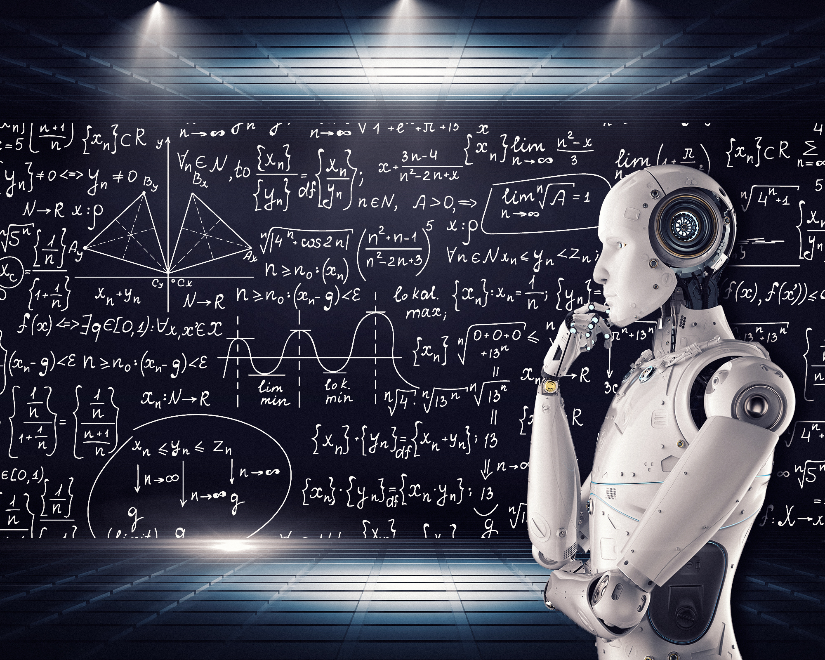
Machine Learning
An Artificial Neural Network(ANN) or Neural Network(NN) is information processing unit that has some characteristics in common with biological neural network.
ANNs have been developed as generalizations of mathematical models of human cognition or neural biology, based on assumption that:
Information occur at many simple elements called neurons
Signal are passed between neurons over connection links
Each connection has been associated weight, which in NN multiplied signal transmitted.
Each neuron applies an activation function(usually nonlinear), to its net input(sum of weighted input signals), to determine its output signals.
A NN consist of Large number of simple processing elements called neurons, cells, units, or nodes.
A NN is categorized by three important factors, architecture and training or learning algorithm and activation function.
A) Architecture: NN pattern of connection between neurons
B) Training or Leaning algorithm: NN method of determining the weights on the connections
C) Activation Function: Whether a Neuron fires or not (Threshhold)

Slide 18
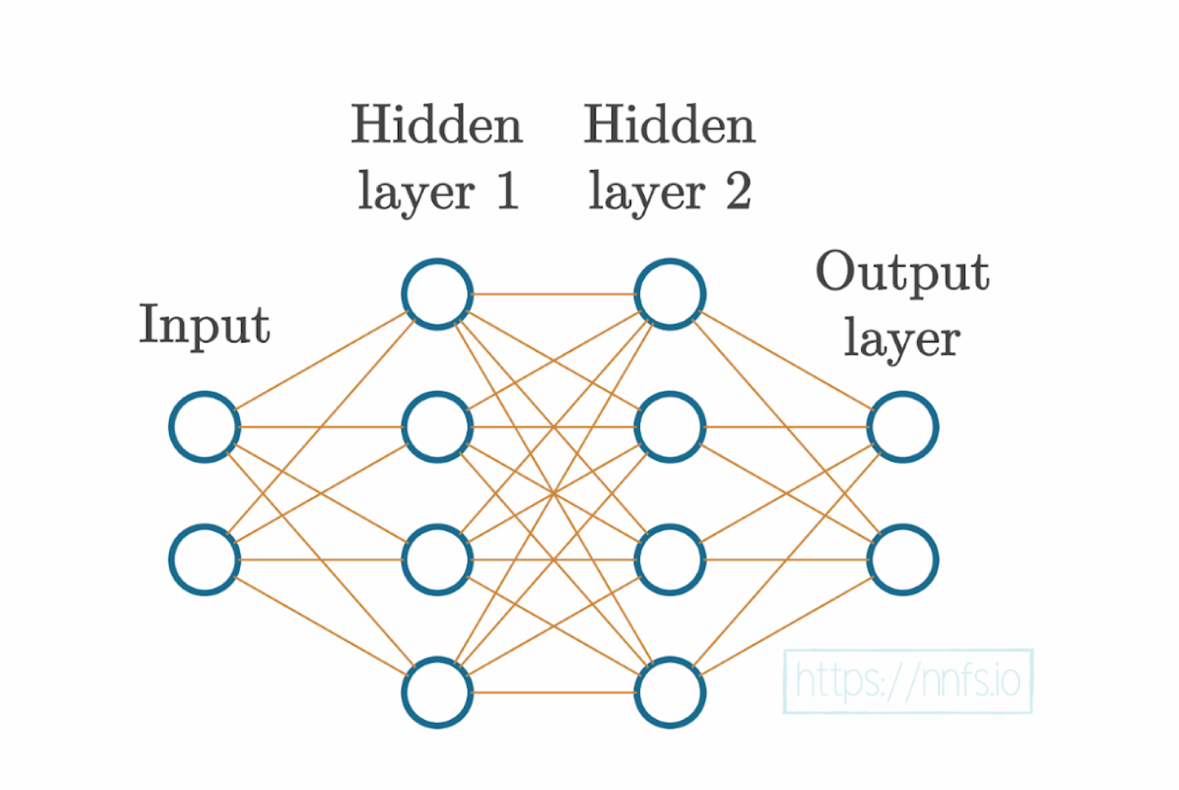
Introduction to Artificial Neural Networks
Artificial neural networks (ANNs),
Multi-layer perceptron, are a collection of multiple perceptrons,
The connection between perceptrons occurs through layers, where one layer can have as many perceptrons as desired, and they are all connected
Networks can have one or more layers. Networks with over four layers are considered to be deep neural networks and are commonly used to solve complex and abstract data problems.
Hidden layers perform complex computations on the input data, extracting features and patterns.
The input layer receives data that the network will learn from. Each node represents a feature or attribute.
The output layer produces the final prediction/result of the neural network.

Slide 19
ANNs are typically composed of three main elements,
1) Input layer: This is the first layer of the network, furthest left in the graphical representation of a network.
It receives the input data before any calculation is performed, and completes the first set of calculations,
For supervised learning problems, the input data consists of a pair of features and targets. The job of the network is to uncover the correlation or dependency between the input and output.
2) Hidden layers: Generally , the layers between input and output layers are termed as the hidden layers.
A neural network can have as many hidden layers as possible.
The more layers it has, the more complex data problems it can tackle,
But more layers also take longer to train.
Surprisingly, some neural network architectures do not contain hidden layers at all, such as single-layer networks
In each layer, a computation is performed based on the information received as input from the previous layer, to output a prediction that will become the input of the subsequent layer.
3) Output layer: This is the last layer of the network, located at the far right of the graphical representation of the network.
It receives data after being processed by all the neurons in the network to make and display a final prediction.
The output layer can have one or more neurons. The former refers to models where the solution is binary, in the form of 0s or 1s.
The latter case consists of models that output the probability of an instance to belong to each of the possible class labels (targets), meaning that the layer will have as many neurons as there are class labels.
Introduction to Artificial Neural Networks ….

Slide 20
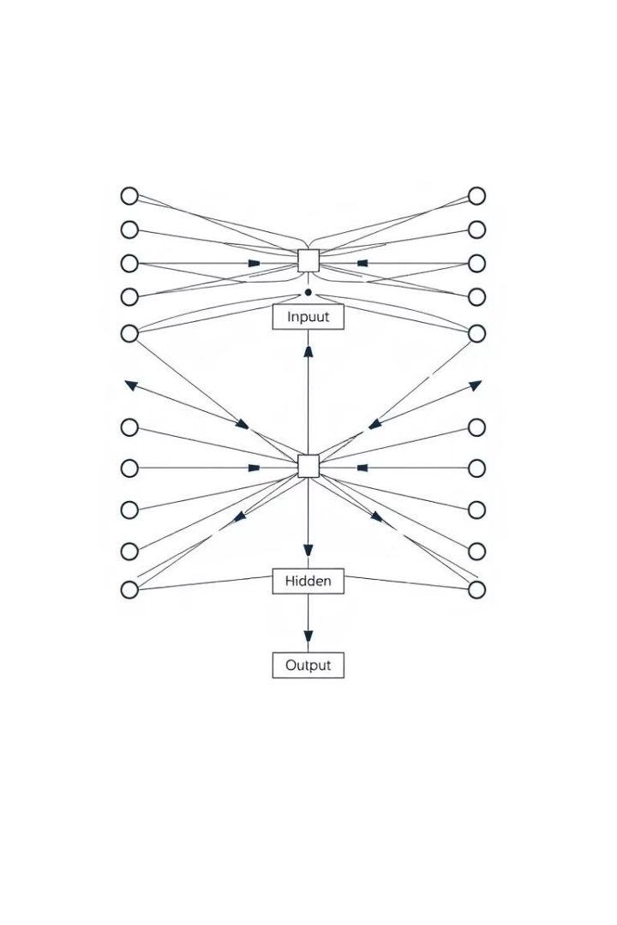
Neural Networks as Directed Graph
1
Input Layer
2
Hidden Layers
The input layer receives data that the network will learn from. Each node represents a feature or attribute.
Hidden layers perform complex computations on the input data, extracting features and patterns.
3
Output Layer
4
Connections and Weights
The output layer produces the final prediction or result of the neural network.
Connections between nodes represent relationships, and weights determine the strength of each connection.

Slide 21
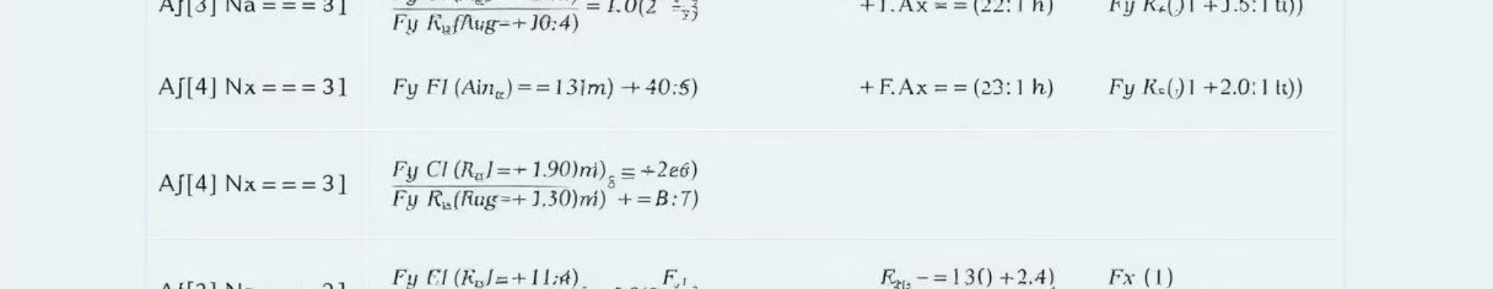
Activation Functions(Threshhold)
Sigmoid
ReLU (Rectified Linear Unit)
Softmax
The sigmoid function squashes outputs between 0 and 1, making it suitable for binary classification tasks.
Softmax normalizes outputs to a probability distribution, suitable for multi-class classification problems.
ReLU outputs the input if positive and 0 otherwise, improving performance in deep neural networks.

Slide 22

Training Neural Networks
1
Feedforward
Data flows through the network from input to output, activating nodes and calculating predictions.
2
Backpropagation
The error between the predicted and actual output is used to adjust weights, iteratively improving accuracy.
3
Optimization
Algorithms like gradient descent are used to find the optimal set of weights that minimize error.

Slide 23
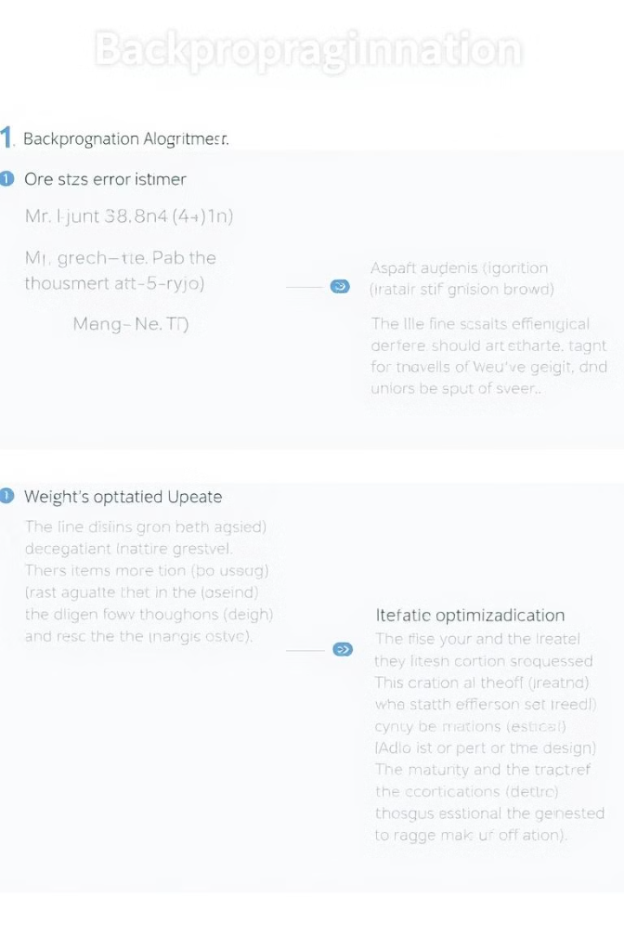

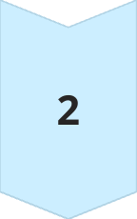

Backpropagation Algorithm
Forward Pass
Data flows through the network, activating nodes and calculating outputs.
Error Calculation(Loss)
The difference between the predicted and actual outputs is calculated.
Backwards Propagation
The error signal is propagated backwards through the network, adjusting weights to minimize error.

Slide 24

Applications of Neural Networks
Image Recognition
Object detection, facial recognition, medical imaging analysis
Natural Language Processing
Machine translation, text summarization, sentiment analysis
Self-Driving Cars
Perception, navigation, decision-making
Medical Diagnosis
Disease prediction, personalized treatment recommendations

Slide 25

PROMINENT PEOPLE IN FIELD OF DEEP LEARNING

Slide 26


Slide 27

Conclusion
Neural networks have revolutionized the field of artificial intelligence, enabling machines to learn and solve complex problems. As research and development continue, we can expect even more innovative applications and breakthroughs in the future.

Slide 28
Conclusion
Neural networks have revolutionized the field of artificial intelligence, enabling machines to learn and solve complex problems. As research and development continue, we can expect even more innovative applications and breakthroughs in the future.

Slide 29
Extras
Overview of the Human Nervous System
Three-Stage System:
The human nervous system operates as a three-stage system centered around the brain (neural net).
Receptors: Convert stimuli into electrical impulses sent to the brain.
Effectors: Convert the brain's electrical impulses into responses.
Feedback Mechanism: Arrows in the system diagram represent the flow of information and feedback loops.
Neuron Fundamentals:
Neurons: Brain cells that process information. They operate slower than silicon chips but have vast interconnections.
Synapses: Junctions where neurons connect, converting electrical signals to chemical signals and back.
Neuron Properties:
Around 10 billion neurons in the human cortex.
Approximately 60 trillion synaptic connections.
Plasticity: The brain adapts through the formation and modification of synaptic connections.
Neuron Structure and Function:
Axons and Dendrites:
Axons: Long, smooth transmission lines.
Dendrites: Shorter, branched receptive zones.
Pyramidal Cells: Common cortical neurons that can receive thousands of synaptic inputs.
Action Potentials: Electrical pulses that neurons use to communicate, circumventing the resistance of long axons.
Brain Organization:
Hierarchical Structure: The brain has a complex, hierarchical structure ranging from synapses to large neural circuits.
Topographic Maps: Sensory inputs are mapped in an orderly fashion in the brain, corresponding to different sensory regions.
Differences from Digital Computers: The brain's structural organization is far more advanced than current artificial neural networks.
Modeling Neurons in Artificial Neural Networks:
Basic Elements:
Synapses: Connections with variable weights.
Adder: Sums input signals.
Activation Function: Limits the output amplitude of a neuron.
Bias: Modifies the neuron's net input.
Activation Functions:
Threshold Function: Produces a binary output (0 or 1).
Sigmoid Function: Produces a smooth output between 0 and 1, often used in neural networks for its differentiability.

Slide 30
Course Name: Credit Hours: Prerequisites: Course Outline: Artificial Neural Networks (ANN) 3 (2+1) Discrete Structure
Introduction to cybernetics, Brain and Neural System as Cybernetics, Type of Neural Networks, Static and Dynamic Neural Networks, Neuron Models. Network Architecture and Toplogy, Training and Validation Procedure, Perceptron, Hamming Network, Feed forward Layer, Recurrent Layer, Perceptron Learning Rule, Proof of Convergence, Signals and Weight Vector Space, Linear Transformation, Performance Surface and Optimization, Hebbian and Widrow-Hoff Learning, Back-propagation and Variations. Associative Learning, Competitive Networks using SOM, Biological Motivation for Vision using Grossberg Network, Adaptive Resonance Theory, Hopfield Network, Cellular Neural Network. Evolutionary Neural Network, Spike Neural Networks, Application of Neural Networks in Signal and Image Processing, Bioinformatics, Telecommunication and High Energy Physics. Quantum Neural Networks.
Neural Network Design, Martin T. Hagan, Howard B. Demuth, Mark H. Beale, ISBN: 0-9717321-0-8

Slide 31
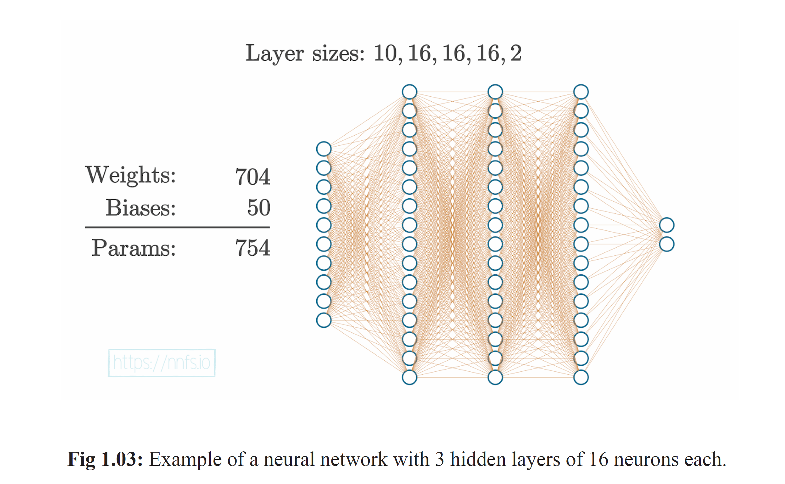


Adopted

